Slide 1

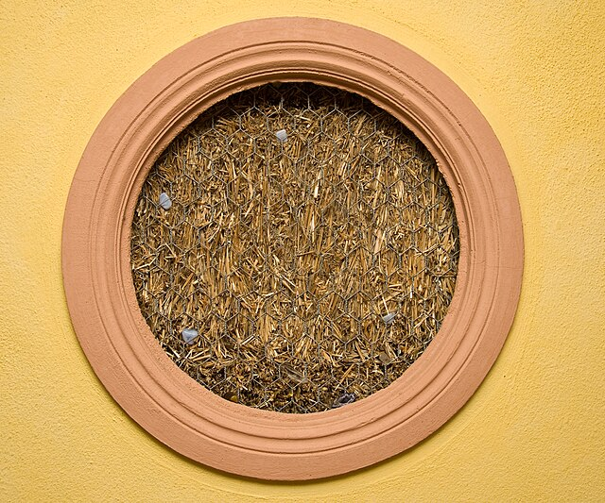
Advantages to Straw Bale vs. Traditional Construction
Presented by Alechrisney Green Construction
Pictured: Truth Window created to display the material used within the home.

Slide 2

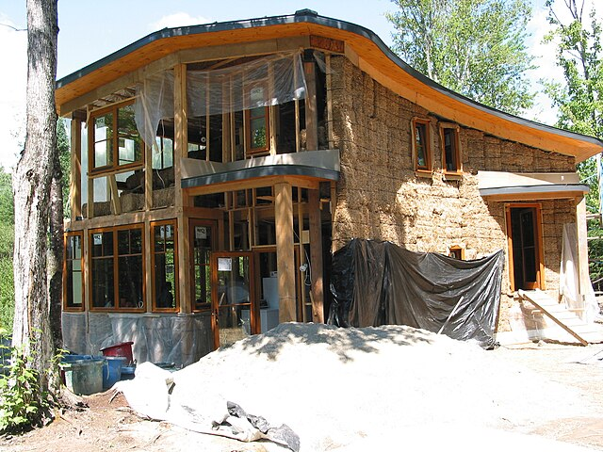
Sustainable Raw Materials
As the price of lumber continues to rise, straw bales become a more appealing option. Straw from wheat, rice, rye, or oats grows much faster and easier than new trees for lumber.
Pictured: New home being constructed using Straw Bale Construction.

Slide 3
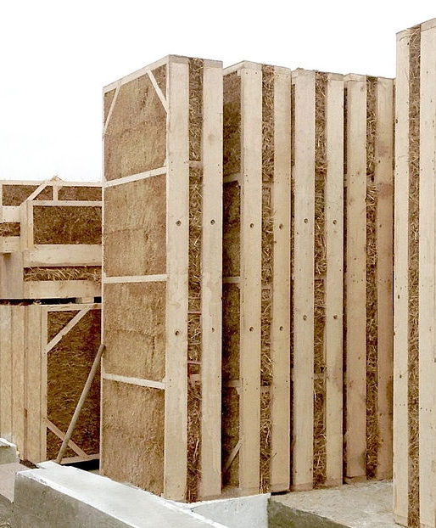
High Insulation Value
While construction costs are comparable to traditional methods, the energy efficiency of a straw bale house can save homeowners money over the years. Sound insulation is also excellent and would be especially appealing in multiple unit structures.
Pictured: Compacted Straw Bale walls.

Slide 4
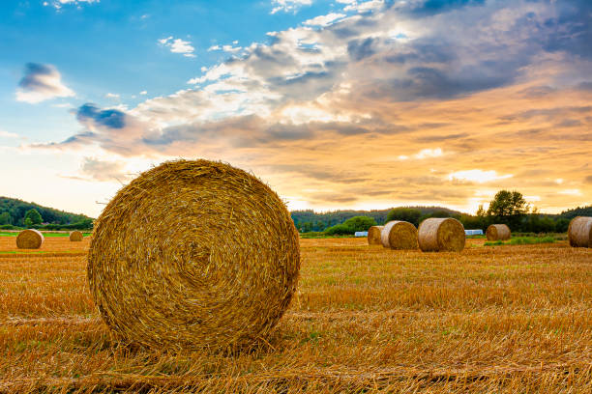
Locally Sourced
Straw bales are readily available in most locations, so the carbon footprint of a straw bale home can be much smaller than materials being shipped from multiple locations.
Pictured: Straw bales in a field.

Slide 5

Naturally Fire-Resistant
The bales are compacted enough that oxygen levels are low, discouraging the spread of fire. In one test, it took two hours for fire to penetrate the plastered bale walls while a conventional frame took only 30 minutes to burn.
Pictured: Straw against a hazy sky.

Slide 6
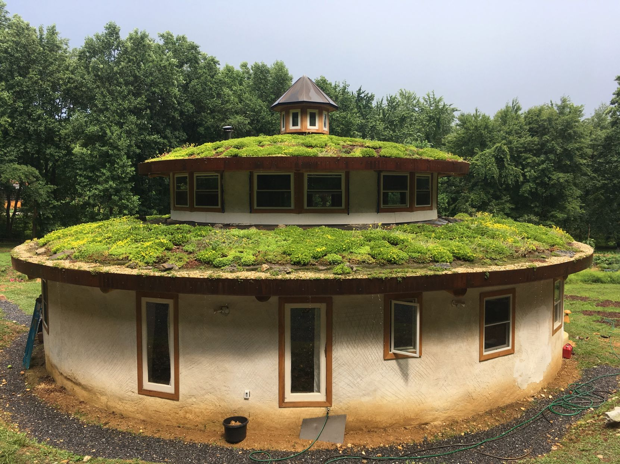
Proven Methods
Midwest homesteading in the early 1900s made use of bale construction, as trees were scarce. The National Register of Historic Places has several entries for these structures that have survived to this day.
Pictured: Straw bale home with a green roof.

Slide 7

Conclusion
Straw bale construction offers homes which:
Utilize sustainable raw materials which are locally sourced.
Maintain a high insulation value.
Are naturally fire-resistant.
Have proven methods that have stood the test of time.

